Slide 1
Bray Team Week 6 Update
Avery Haynes, Locke Lehmann, Travis Carlson, Cody Sims, Zachary Walker, Michael Hager
9/25/2023

Slide 2
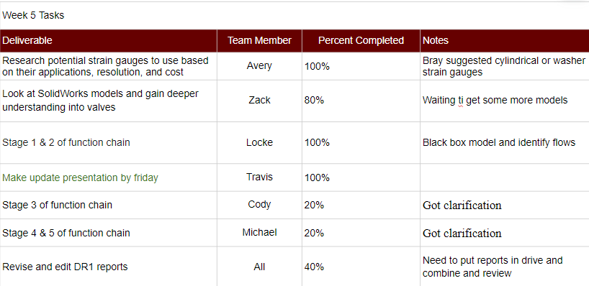
Week 5 deliverables

Slide 3
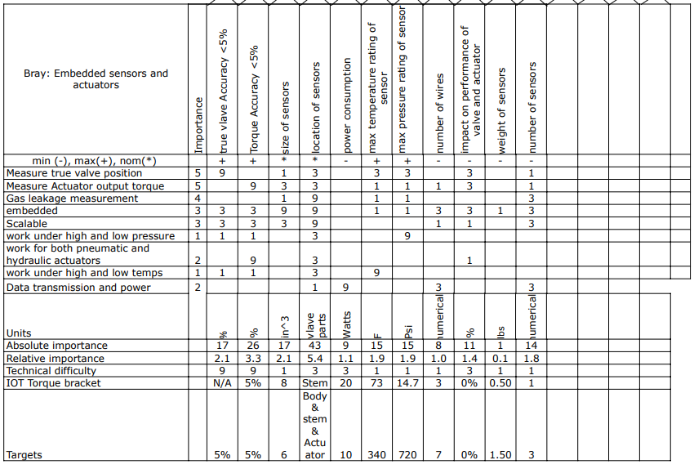
House of Quality
Submitted to bray for review

Slide 4
Black Box Model
Mechanical Energy
Mechanical Energy
Measure Valve Position
Measure Actuator Torque
Electrical Energy
Electrical Energy
Data Signal

Slide 5
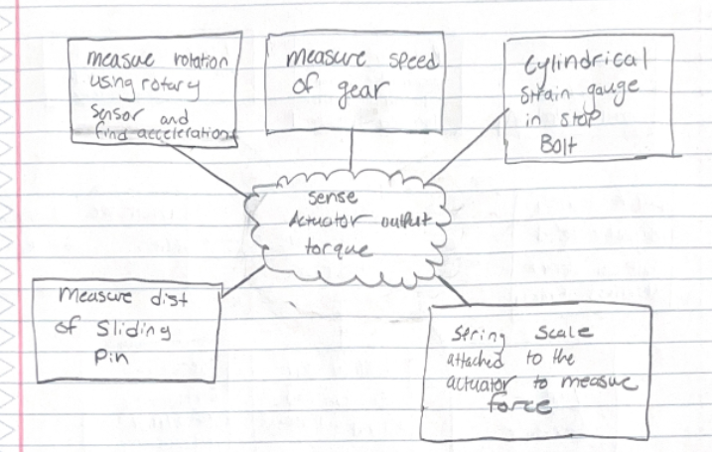
Brainstorming
Actuator output torque deliverable

Slide 6
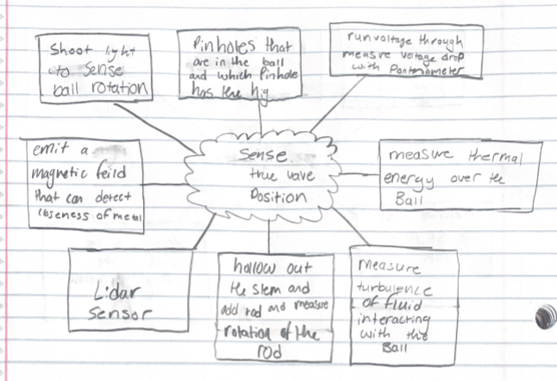
Brainstorming
True valve position deliverable

Slide 7
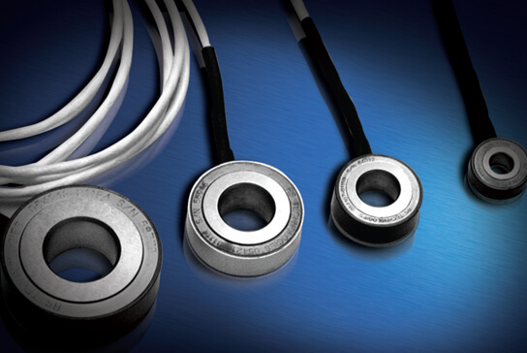
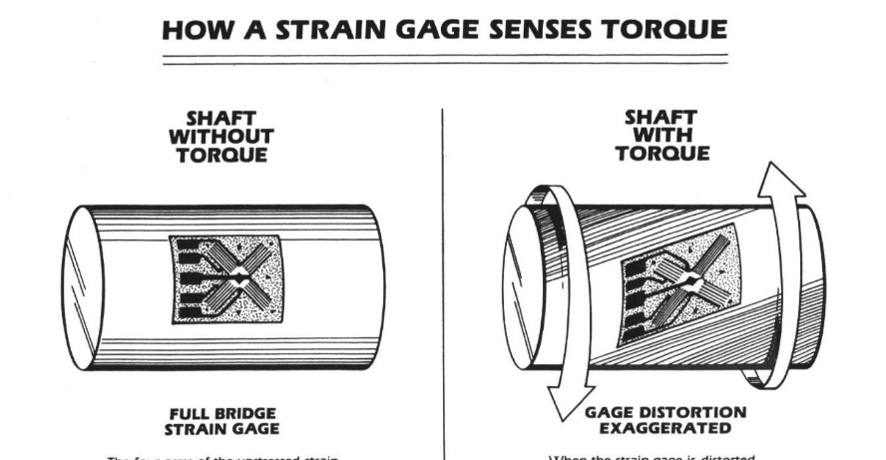
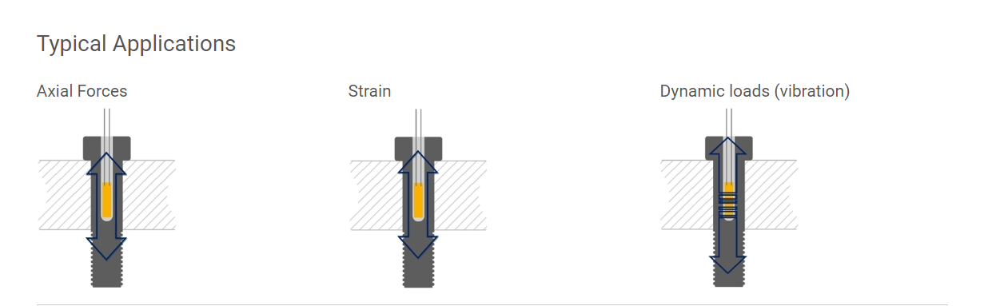
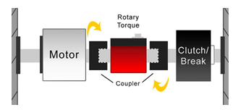
Strain Gauges
Full Bridge Gauge configuration to sense torque:
Measures shaft torsion
Could be attached to any stationary part against the stop bars that receives a torque
Washer Strain Gauges:
Used in place of a washer in a fastener assembly
Measures axial loads
Placed inline with stop bars
Cylindrical Strain Gauges:
Placed inside a fixed fastener
Measures axial loads, not torsional
Could be placed on a stop bar. (inside the rotating shaft?)
Rotational Torque Sensor:
Direct torque measurement
Rotary transducer & slip ring mounted in-line with shaft
Mounted between actuator and valve stem

Slide 8
Week 6 plans
Week 6 Tasks
Deliverable | Team Member | Percent Completed | Notes
Organize Brainstorming and narrow ideas | Avery | 0%
Brainstorm more ideas | Locke | 20%
look over DR1 reports | zach | 0%
function stage 2/3 | Cody | 20%
function stage 4/5 | Michael | 20%
continue revising DR! | All | 40%

Slide 9
Current/Upcoming Tasks
Research Topics/Deliverables:
Brainstorming ideas for detecting true valve position/torque
Function Chain
Review SolidWorks parts and assemblies
Narrow down concepts

